Slide 1


Slide 2
Browsers
JS Objects Model
Basic Javascript
Operations
Browsers

Slide 3
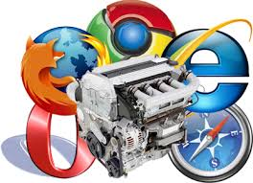
HOW BROWSERS WORK

Slide 4
HOW BROWSERS WORK
RENDER ENGINE
JAVASCRIPT ENGINE

Slide 5
HOW BROWSERS WORK
HTML & CSS
JS
RENDER ENGINE
JAVASCRIPT ENGINE

Slide 6

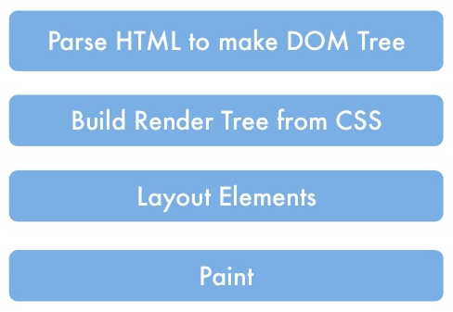
HOW BROWSERS WORK

Slide 7
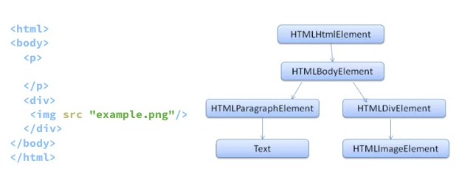
HOW BROWSERS WORK
WHAT’S A DOM TREE

Slide 8
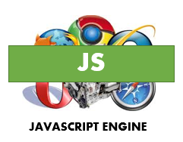
HOW BROWSER WORKS
Javascript could modify the DOM Tree
Javascript should be executed when the DOM Tree is loaded.

Slide 9
How browsers work
HTML & CSS
JS
RENDER ENGINE
JAVASCRIPT ENGINE

Slide 10
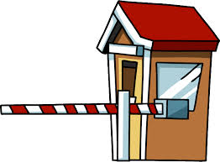
How browsers work
HTML & CSS
JS
TOLL
RENDER ENGINE
JAVASCRIPT ENGINE

Slide 11
Browsers
JS Objects Model
Basic Javascript
Operations
JS Objects Model

Slide 12
JS OBJECTS MODEL
BOM
DOM
JAVASCRIPT

Slide 13
JS OBJECTS MODEL
BOM
window
document
navigator
alert
history
screen
location
console*

Slide 14
JS OBJECTS MODEL
DOM
window
document
element
nodeList
attribute
namedNodeMap

Slide 15
Browsers
JS Objects Model
Basic Javascript
Operations
Basic Javascript

Slide 16
BASIC JAVASCRIPT
DATA TYPES
STRING:
NUMBER:
BOOLEAN:
NULL:
UNDEFINED:
“IRON” / ‘HACK’
true / false
null
undefined
2

Slide 17
BASIC JAVASCRIPT
DATA TYPES
STRING:
NUMBER:
BOOLEAN:
NULL:
UNDEFINED:
“IRON” / ‘HACK’
true / false
null
undefined
2
typeof

Slide 18
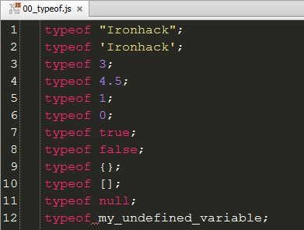
BASIC JAVASCRIPT
DATA TYPES - typeof

Slide 19
BASIC JAVASCRIPT
VARIABLES
My name is Tomas
I live in Barcelona
I teach Javascript

Slide 20
BASIC JAVASCRIPT
VARIABLES
My name is Tomas
I live in Barcelona
I teach Javascript
“My name is”
“I live in”
“I teach”

Slide 21
BASIC JAVASCRIPT
VARIABLES
My name is:
I live in:
I teach:

Slide 22
BASIC JAVASCRIPT
VARIABLES
My name is:
I live in:
I teach:
Tomas
Barcelona
Javascript

Slide 23
BASIC JAVASCRIPT
VARIABLES
name =
live =
teach =
Tomas
Barcelona
Javascript

Slide 24
BASIC JAVASCRIPT
VARIABLES
var name =
var live =
var teach =
Tomas
Barcelona
Javascript

Slide 25
BASIC JAVASCRIPT
VARIABLES
var name =
var live =
var teach =
‘Tomas’
‘Barcelona’
‘Javascript’

Slide 26
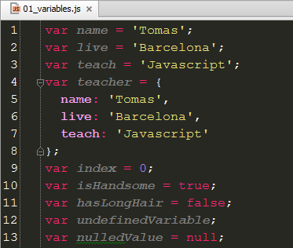
BASIC JAVASCRIPT
VARIABLES

Slide 27
BASIC JAVASCRIPT
VARIABLES
Store data in memory to use it later
Naming…

Slide 28
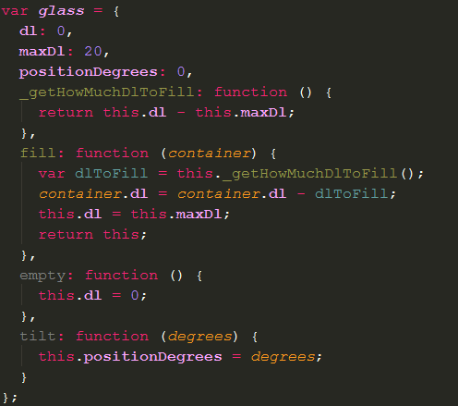
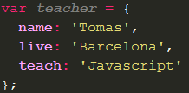
}
{
)
[
]
(
BASIC JAVASCRIPT
OBJECTS

Slide 29
}
{
)
[
]
(
BASIC JAVASCRIPT
OBJECTS
In Javascript all is an object and probably a function too.
Native objects:
String, Number, Boolean, Object, Array, Function, Date…
An object is a representation of data.
An object can have properties/members and functions/methods.

Slide 30
}
{
)
[
]
(
BASIC JAVASCRIPT
OBJECTS
Constructors
Prototypes
OOP
Inheritance

Slide 31
}
{
)
[
]
(
BASIC JAVASCRIPT
OBJECTS
We will revisit objects section during all the course
We will learn what is and how to use OOP (Object Oriented Paradigm).

Slide 32
BASIC JAVASCRIPT
FUNCTIONS
I DRINK WATER
I RUN KM
I PLAY FOOTBALL
I STUDY JAVASCRIPT
5

Slide 33
BASIC JAVASCRIPT
FUNCTIONS
TEACHER DRINKS WATER
TEACHER RUNS KM
TEACHER PLAYS FOOTBALL
TEACHER STUDIES JAVASCRIPT
5

Slide 34
)
(
BASIC JAVASCRIPT
FUNCTIONS
(
)
TEACHER DRINKS ‘WATER’
TEACHER RUNS
TEACHER PLAYS ‘FOOTBALL’
TEACHER STUDIES ‘JAVASCRIPT’
(
5
)
(
)
(
)

Slide 35
)
(
BASIC JAVASCRIPT
FUNCTIONS
(
)
TEACHER.DRINKS ‘WATER’
TEACHER.RUNS
TEACHER.PLAYS ‘FOOTBALL’
TEACHER.STUDIES ‘JAVASCRIPT’
(
5
)
(
)
(
)

Slide 36
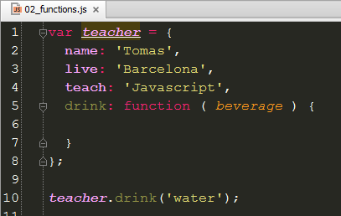
)
(
BASIC JAVASCRIPT
FUNCTIONS
(
)
TEACHER.DRINK ‘WATER’

Slide 37

)
(
BASIC JAVASCRIPT
FUNCTIONS
(
)
TEACHER.DRINK ‘WATER’

Slide 38

)
(
BASIC JAVASCRIPT
FUNCTIONS
(
)
TEACHER.DRINK ‘WATER’

Slide 39
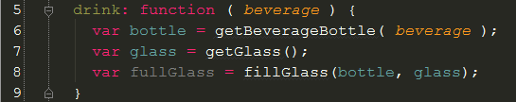
)
(
BASIC JAVASCRIPT
FUNCTIONS
(
)
TEACHER.DRINK ‘WATER’

Slide 40
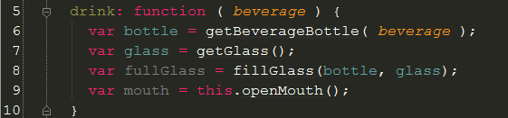
)
(
BASIC JAVASCRIPT
FUNCTIONS
(
)
TEACHER.DRINK ‘WATER’

Slide 41
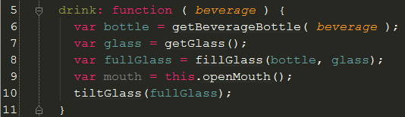
)
(
BASIC JAVASCRIPT
FUNCTIONS
(
)
TEACHER.DRINK ‘WATER’

Slide 42
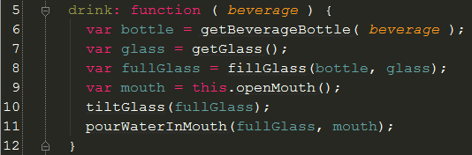
)
(
BASIC JAVASCRIPT
FUNCTIONS
(
)
TEACHER.DRINK ‘WATER’

Slide 43
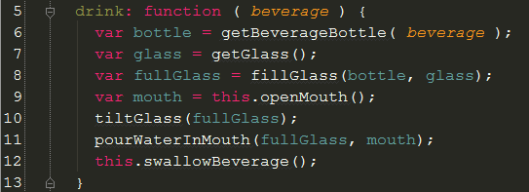
)
(
BASIC JAVASCRIPT
FUNCTIONS
(
)
TEACHER.DRINK ‘WATER’

Slide 44
)
(
BASIC JAVASCRIPT
FUNCTIONS
Define actions to be executed.
A function can execute other functions
A function always returns something even when you don’t return anything.
A function can return and get other function/s

Slide 45
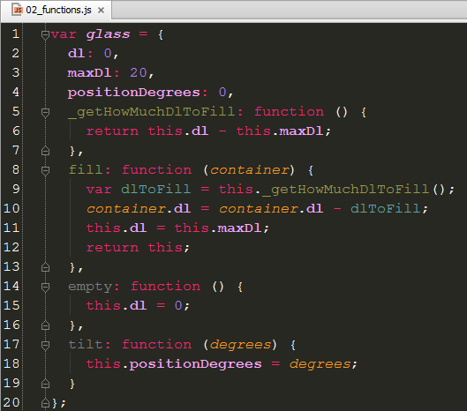
)
(
BASIC JAVASCRIPT
FUNCTIONS - this

Slide 46
)
(
BASIC JAVASCRIPT
FUNCTIONS - this
this is a internal variable that returns the same object or function* where is called
* A function is an object

Slide 47
)
(
BASIC JAVASCRIPT
CONDITIONALS
IF I TYPE MY KEYBOARD A MESSAGE IS SHOWN IN CONSOLE
IF I DON’T DRINK I’M THIRSTY
IF I DON’T SHAVE MI SON DON’T KISS ME BUT IF I DO MY SON KISS ME TWO TIMES

Slide 48
}
{
)
(
BASIC JAVASCRIPT
CONDITIONALS
)
IF I TYPE MY KEYBOARD A MESSAGE IS SHOWN IN CONSOLE
IF I DON’T DRINK I’M THIRSTY
IF I DON’T SHAVE MI SON DON’T KISS ME BUT IF I DO MY SON KISS ME TWO TIMES
(
{
}
(
)
{
}
(
)
{
}
(
)
{
}

Slide 49
}
{
)
(
BASIC JAVASCRIPT
CONDITIONALS
(
)
(
)
}
IF TYPING CONSOLE.SHOWMESSAGE
IF TEACHER.ISTHIRSTY TEACHER.DRINK
IF SHAVED SON.KISSTIMES ME, ELSE SON.KISSTIMES ME,
{
(
)
{
(
)
}
(
)
{
(
2
)
}
{
(
0
)
}

Slide 50
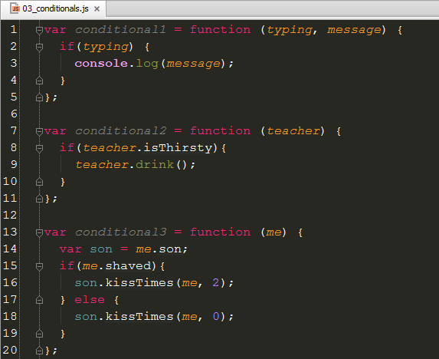
}
{
)
(
BASIC JAVASCRIPT
CONDITIONALS

Slide 51
}
{
)
(
BASIC JAVASCRIPT
CONDITIONALS
CONDITIONALS ARE USED TO CHECK BOOLEAN VALUES TO DECIDE WHAT TO DO.
Operators: II - && - != - !== - == - ===…
OTHER CONDITIONALS INSTRUCTIONS:
SWITCH
TERNARY OPERATOR
ARRAY*
* An array can be used to improve performance in big conditionals.

Slide 52
}
{
)
(
BASIC JAVASCRIPT
ARRAYS
I SHOULD BUY TEA, BREAD AND BUTTER FOR BREAKFAST
MY FRIENDS ARE DIEGO, SERGIO, JOFRE, DIANA AND CECILIA
I TRAVELED LAST YEAR TO PARIS, MADRID, BERLIN AND ROMA

Slide 53
}
{
[
)
]
(
BASIC JAVASCRIPT
ARRAYS
[
]
I SHOULD BUY TEA, BREAD AND BUTTER FOR BREAKFAST
MY FRIENDS ARE DIEGO, SERGIO, JOFRE, DIANA AND CECILIA
I TRAVELED LAST YEAR TO PARIS, MADRID, BERLIN AND ROMA
[
]
[
]

Slide 54
}
{
[
)
]
(
BASIC JAVASCRIPT
ARRAYS
[
]
BREAKFAST BUY LIST = TEA, BREAD, BUTTER
MY FRIENDS ARE = DIEGO, SERGIO, JOFRE, DIANA, CECILIA
LAST YEAR TRAVELS = PARIS, MADRID, BERLIN AND ROMA
[
]
[
]

Slide 55
}
{
[
)
]
(
BASIC JAVASCRIPT
ARRAYS
[
]
BREAKFASTBUYLIST = TEA, BREAD, BUTTER
MYFRIENDS = DIEGO, SERGIO, JOFRE, DIANA, CECILIA
LASTYEARTRAVELS = PARIS, MADRID, BERLIN AND ROMA
[
]
[
]

Slide 56
}
{
[
)
]
(
BASIC JAVASCRIPT
ARRAYS
[
]
BREAKFASTBUYLIST = TEA, BREAD, BUTTER
MYFRIENDS = DIEGO, SERGIO, JOFRE, DIANA, CECILIA
LASTYEARTRAVELS = PARIS, MADRID, BERLIN AND ROMA
[
]
[
]

Slide 57
}
{
[
)
]
(
BASIC JAVASCRIPT
ARRAYS
Arrays in Javascript as Javascript are not strong typed so you can mix different types in a same array but is considered a bad practice.
Arrays is a set/list of ítems that you want to store so that you can loop over them to make some process over them. (Draw a list, increase VAT…)

Slide 58
}
{
[
)
]
(
BASIC JAVASCRIPT
LOOPS
I GIVE A PRESENT TO MY FRIENDS ALEIX, AIDA, MIGUEL
I BUY BUTTER, BREAD, BACON AND TEA
I CLEAN THE TEN DISHES AND THE SIX GLASSES

Slide 59
}
{
[
)
]
(
BASIC JAVASCRIPT
LOOPS
[
]
I GIVE A PRESENT TO MY FRIENDS ALEIX, AIDA, MIGUEL
I BUY BUTTER, BREAD, BACON, TEA
I CLEAN THE TEN DISHES AND THE SIX GLASSES
[
]
[
]
[
]

Slide 60
}
{
)
[
]
(
BASIC JAVASCRIPT
LOOPS
(
)
(
)
GIVEPRESENT ALEIX GIVEPRESENT AIDA GIVEPRESENT MIGUEL
BUY BUTTER BUY BREAD BUY BACON BUY TEA
CLEAN DISH CLEAN DISH CLEAN DISH …
(
)
(
)
(
)
(
)
(
)
(
)
(
)
(
)

Slide 61


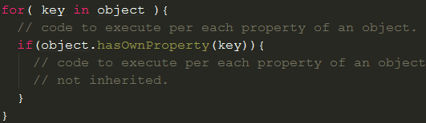

}
{
)
[
]
(
BASIC JAVASCRIPT
LOOPS
for
while
for-in
do-while

Slide 62
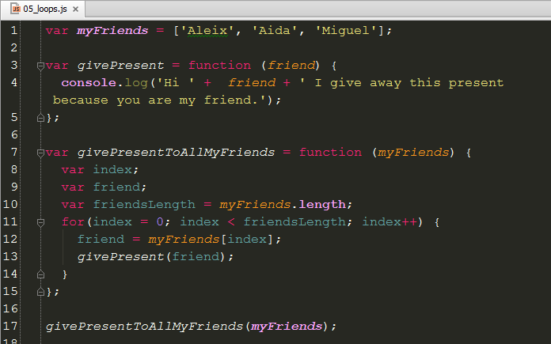
}
{
)
[
]
(
BASIC JAVASCRIPT
LOOPS

Slide 63
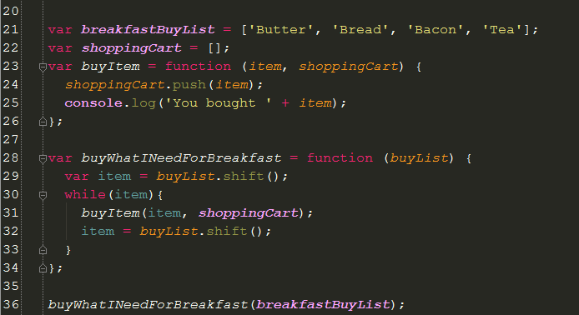
}
{
)
[
]
(
BASIC JAVASCRIPT
LOOPS

Slide 64
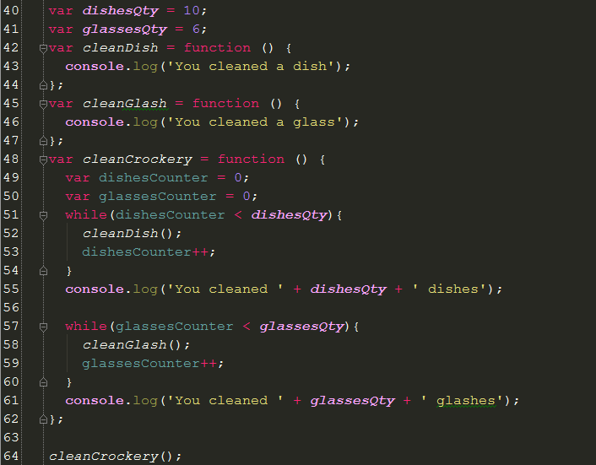
}
{
)
[
]
(
BASIC JAVASCRIPT
LOOPS

Slide 65
}
{
)
[
]
(
BASIC JAVASCRIPT
LOOPS
Other :
https://developer.mozilla.org/en-US/docs/Web/JavaScript/Reference/Global_Objects/Array

Slide 67
Javascript Engine
UI Thread
String
RegExp
De/Increment
Javascript Engine

Slide 68

}
{
)
[
]
(
JAVASCRIPT ENGINE
HOW JAVASCRIPT IS INTERPRETED
REQUEST FILE IF NEEDED

Slide 69

}
{
)
[
]
(
JAVASCRIPT ENGINE
HOW JAVASCRIPT IS INTERPRETED
EVALUATE CONTENT

Slide 70

}
{
)
[
]
(
JAVASCRIPT ENGINE
HOW JAVASCRIPT IS INTERPRETED
EXECUTE CODE

Slide 71

}
{
)
[
]
(
JAVASCRIPT ENGINE
COMPILER JIT

Slide 72
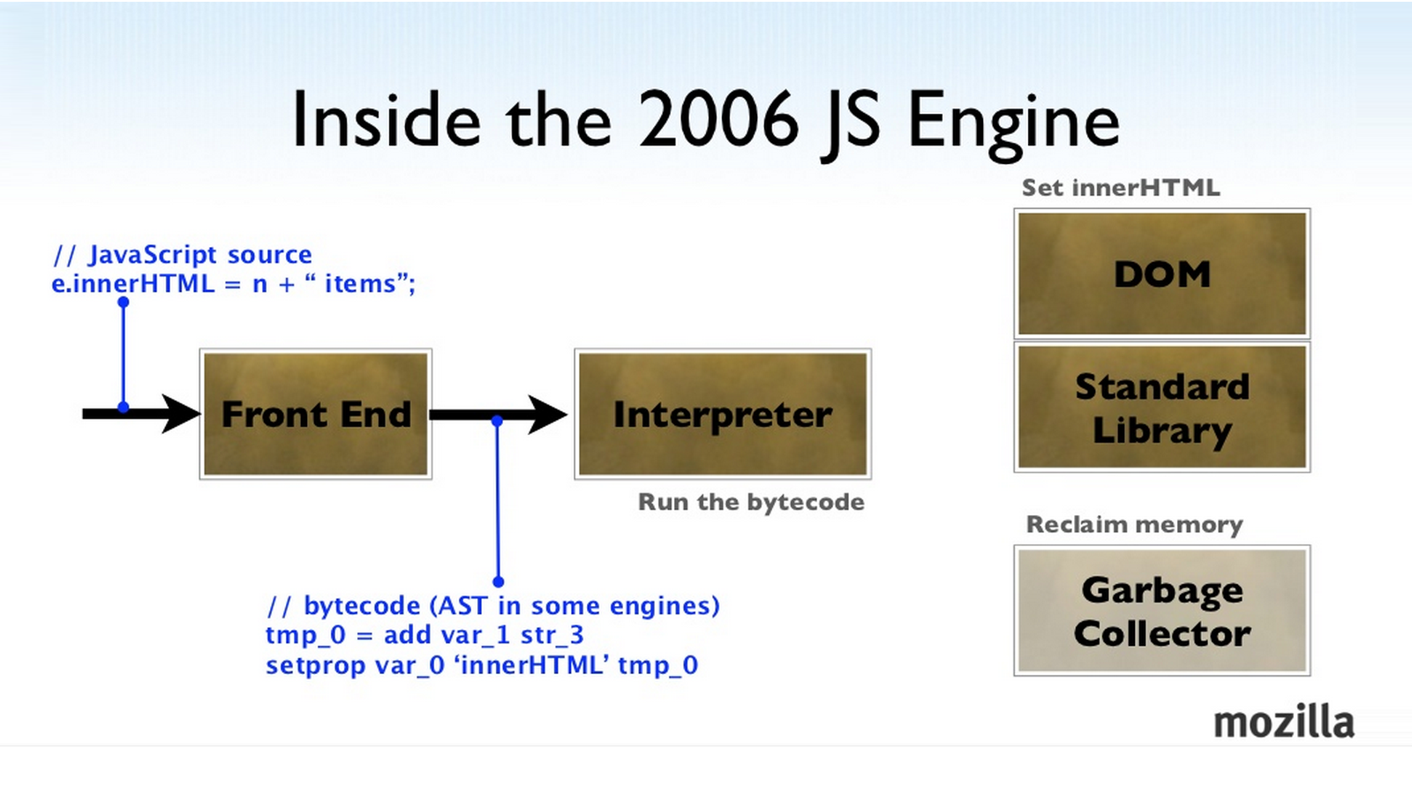
}
{
)
[
]
(
JAVASCRIPT ENGINE
COMPILER JIT

Slide 73
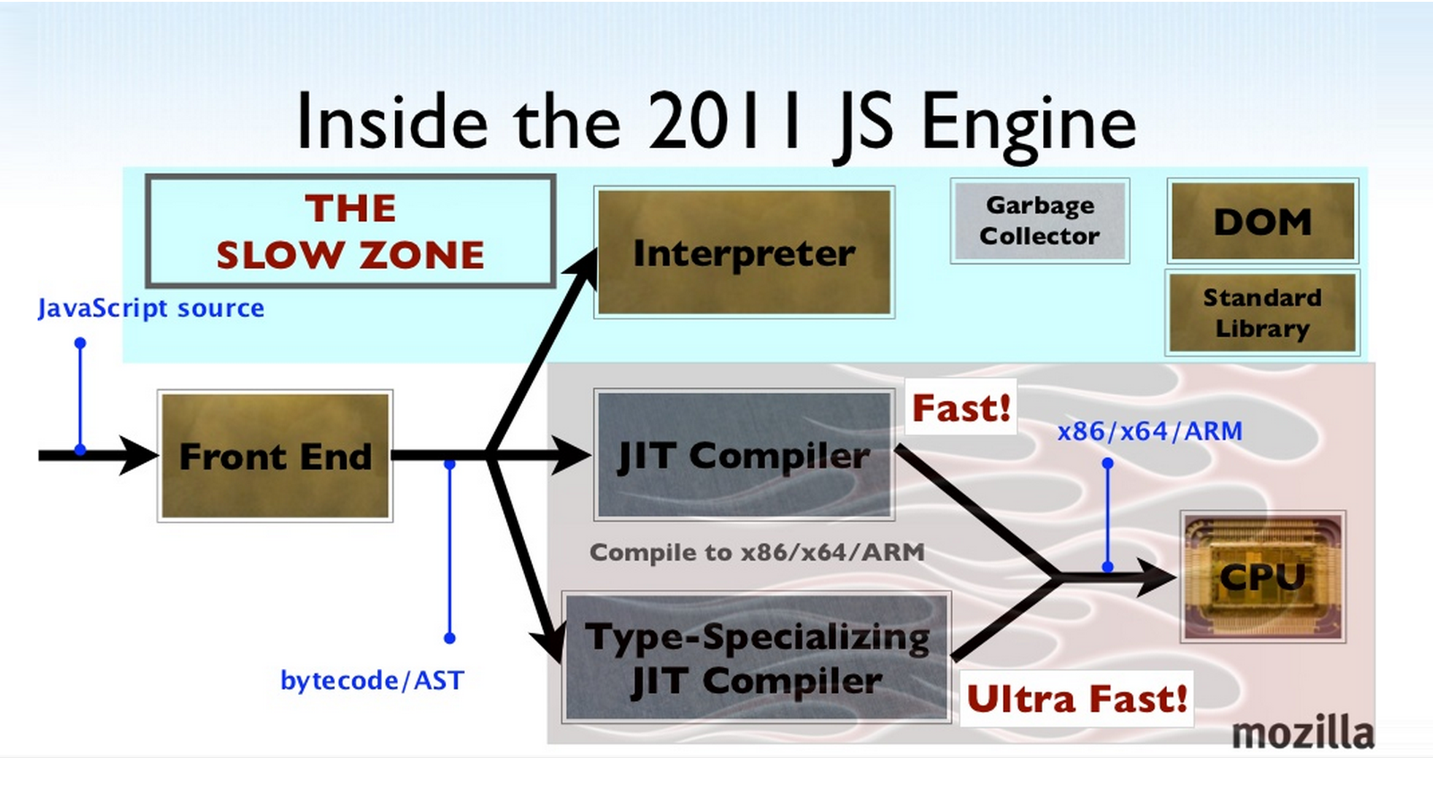
}
{
)
[
]
(
JAVASCRIPT ENGINE
COMPILER JIT

Slide 74
Javascript Engine
UI Thread
String
RegExp
De/Increment
UI Thread

Slide 75
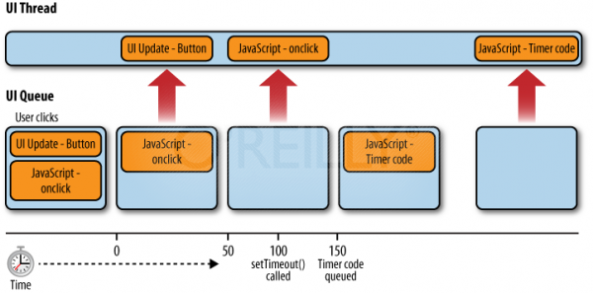
}
{
)
[
]
(
UI Thread
HOW IT WORKS

Slide 76
}
{
)
[
]
(
UI Thread
HOW IT WORKS

Slide 77
Javascript Engine
UI Thread
String
RegExp
De/Increment
String

Slide 78
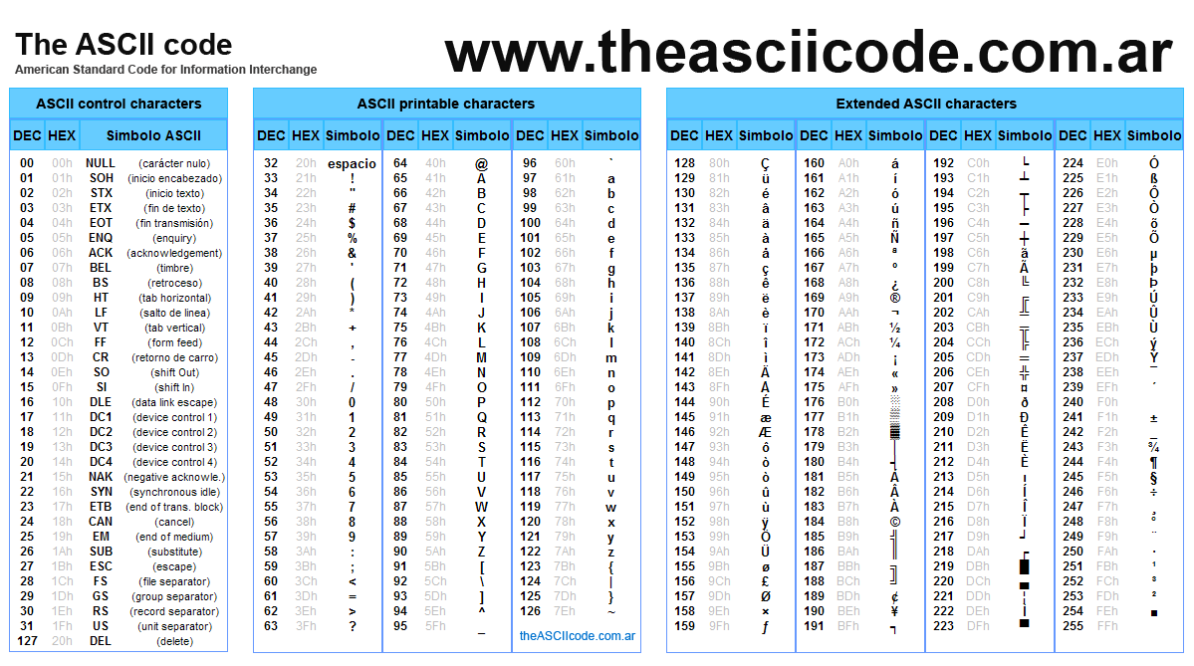
}
{
)
[
]
(
STRING
ASCII CODE

Slide 79
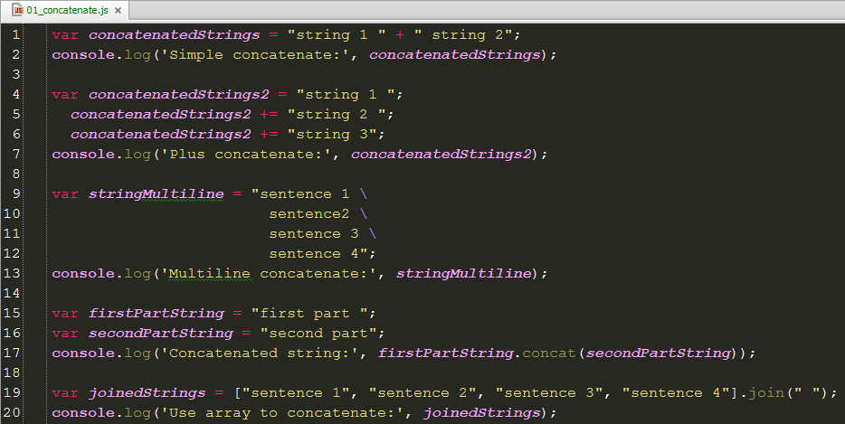
}
{
)
[
]
(
STRING
CONCATENATE

Slide 80
}
{
)
[
]
(
STRING
METHODS
indexOf
charAt
charCodeAt
toLowerCase
toUpperCase
localeCompare
fromCharCode
match
replace
split
substr
slice

Slide 81
Javascript Engine
UI Thread
String
RegExp
De/Increment
RegExp

Slide 82
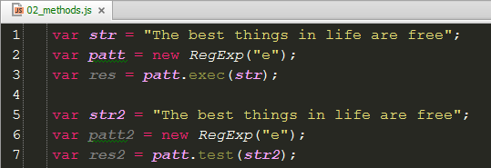
}
{
)
[
]
(
REGEXP
METHODS

Slide 83
}
{
)
[
]
(
REGEXP
METHODS

Slide 84
Javascript Engine
UI Thread
String
RegExp
De/Increment
DE/INCREMENT

Slide 85
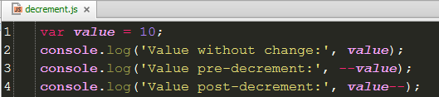
}
{
)
[
]
(
DE/INCREMENT
DECREMENT

Slide 86
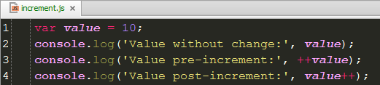
}
{
)
[
]
(
DE/INCREMENT
INCREMENT

Slide 87
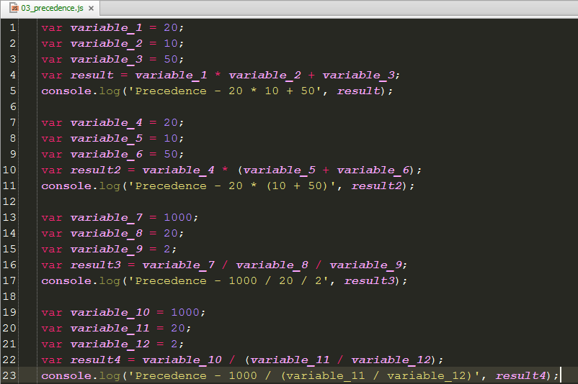
}
{
)
[
]
(
PRECEDENCE

Slide 88
}
{
)
[
]
(
PRECEDENCE
https://developer.mozilla.org/en-US/docs/Web/JavaScript/Reference/Operators/Operator_Precedence

Slide 89
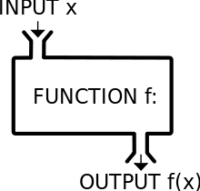
}
{
)
[
]
(
FUNCTION

Slide 90

}
{
)
[
]
(
FUNCTION
SCOPE

Slide 91
}
{
)
[
]
(
OOP
TERMINOLOGY
NAMESPACE

Slide 92
}
{
)
[
]
(
OOP
TERMINOLOGY
NAMESPACE
ANOTHER OBJECT THAT CONTAINS OTHER METHODS, PROPERTIES AND OBJECTS

Slide 93
}
{
)
[
]
(
OOP
TERMINOLOGY
“”CLASS””

Slide 94
}
{
)
[
]
(
OOP
TERMINOLOGY
“”CLASS””
Class doesn’t exist, yet, in Javascript, in Object Oriented Programming is a blueprint that you use to créate instance of an object.

Slide 95
}
{
)
[
]
(
OOP
TERMINOLOGY
OBJECT

Slide 96
}
{
)
[
]
(
OOP
TERMINOLOGY
OBJECT
All in Javascript is an object.

Slide 97
}
{
)
[
]
(
OOP
TERMINOLOGY
PROPERTY

Slide 98
}
{
)
[
]
(
OOP
TERMINOLOGY
PROPERTY
Variables that store data that exist in the context of an object.
Properties should have something in common with the object.

Slide 99
}
{
)
[
]
(
OOP
TERMINOLOGY
METHOD

Slide 100
}
{
)
[
]
(
OOP
TERMINOLOGY
METHOD
Function that exist in the context of an object and have Access to the object itself.

Slide 101
}
{
)
[
]
(
OOP
TERMINOLOGY
CONSTRUCTOR

Slide 102
}
{
)
[
]
(
OOP
TERMINOLOGY
CONSTRUCTOR
Constructor is a function that will be executed when we instanciate an object with new
Constructor returns an object.

Slide 103
}
{
)
[
]
(
OOP
TERMINOLOGY
INHERITANCE

Slide 104
}
{
)
[
]
(
OOP
TERMINOLOGY
INHERITANCE
Used to share behaviours between objects that have something in common.
Ex. Grand-father -> Parent -> Children

Slide 105
}
{
)
[
]
(
OOP
TERMINOLOGY
ENCAPSULATION

Slide 106
}
{
)
[
]
(
OOP
TERMINOLOGY
ENCAPSULATION
Store data or functions that are not public.
Some data could be exposed using other methods like (GET or SET]

Slide 107
}
{
)
[
]
(
OOP
TERMINOLOGY
ABSTRACTION

Slide 108
}
{
)
[
]
(
OOP
TERMINOLOGY
ABSTRACTION
Mental process used to abstract the concepts from the instances.
Ex. Bicicle, Dog…

Slide 109
}
{
)
[
]
(
OOP
TERMINOLOGY
POLYMORPHISM

Slide 110
}
{
)
[
]
(
OOP
TERMINOLOGY
POLYMORPHISM
Process to allow “subclasses” to be used instead of the parent “class”
Car -> Volvo -> Seat…

